Slide 1
Lending club Case Study
Prepared by:
Akhilesh Dwivedi
Abrar Lohia

Slide 2
Agenda
Objective
Analyse loan data
Cleaning of data
Identify Key features
Univariate analysis
Bivariate analysis
Data Visualisation
Conclusion

Slide 3
Objective
Identify risky loan Applicants
Minimizing the loss

Slide 4
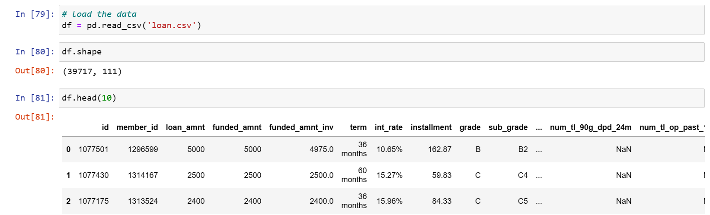
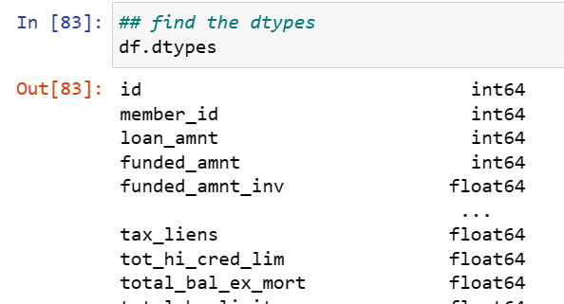
Data ingestion and analysis
Loaded loan data and analysed the columns, null values and data types:

Slide 5
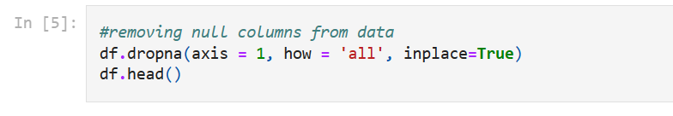
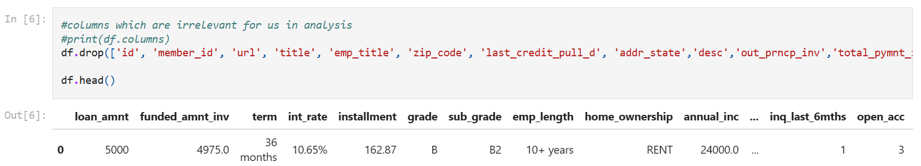
Data cleaning
Removal of missing values
data type conversion

Slide 6
Key features
Important variables are:
loan_amt
Term
Interest_rate
Grade
Subgrade
Annual Income
Purpose of loan
DTI
Emp_lenght
Loan date
Home Ownership
Verification Status

Slide 7
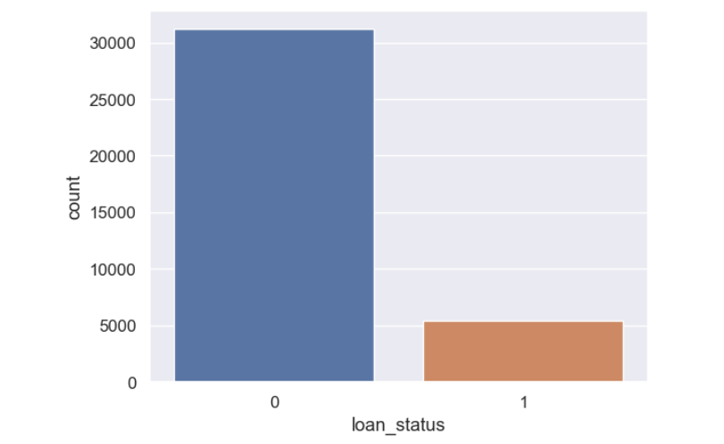
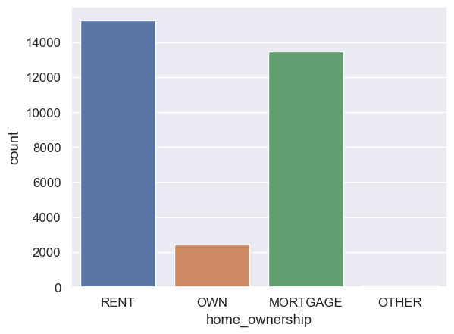
Univariate Analysis
More than 5K loans are risky.
0: fully paid 1: Charged off
Maximum number of people who fully paid the loan are having rented home.

Slide 8
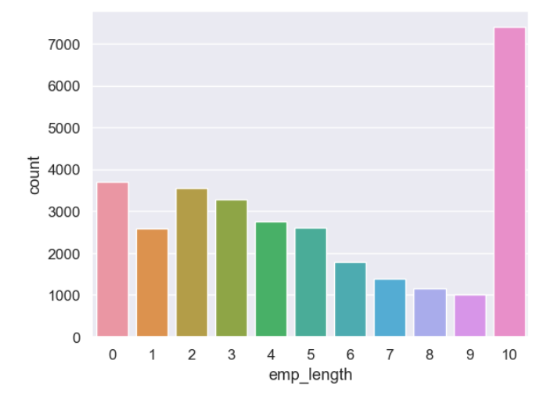
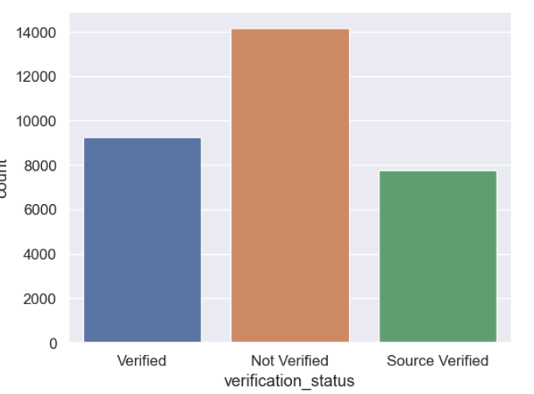
Continued…
Maximum number of applicants who paid the loan were having service length 10 year or more.
Maximum no of applicants who paid loan fully were not verified.

Slide 9
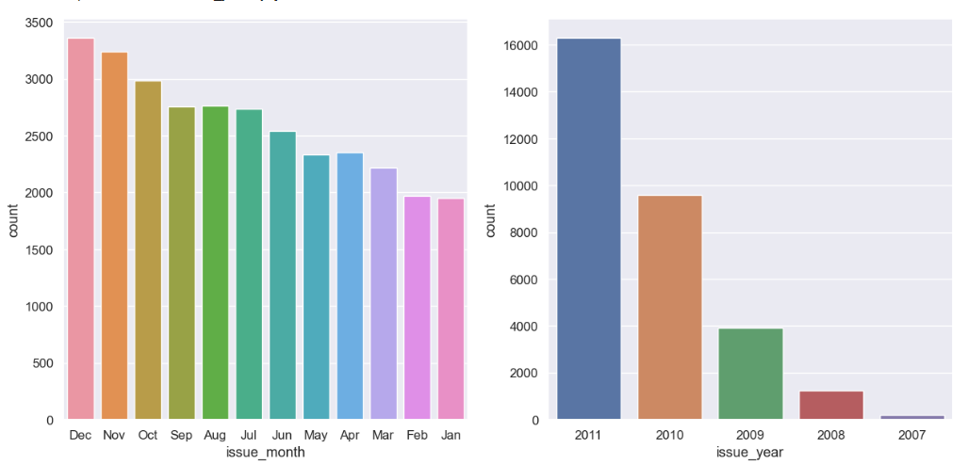
Continued….
Maximum loan we given in year 2011
Dec is the month when maximum loans are disbursed

Slide 10
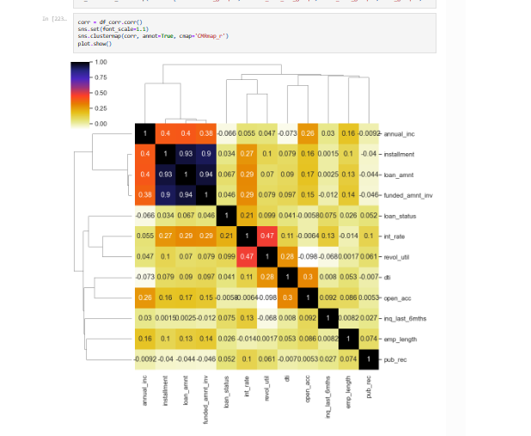
Correlation
Annual Income to dti Ratio are negatively correlated
Loan Amount,Investor Amount and Funding Amount are strongly correlated
Positive correlation between Annual Income and emp_length

Slide 11
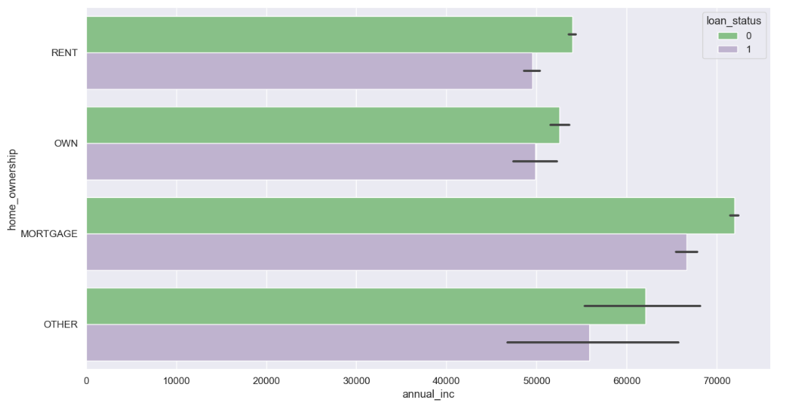
Bivariate Analysis
Maximum number of applicants who didn’t paid load are having home ownership as Mortage.
People with rented home defaulted the loan least.

Slide 12
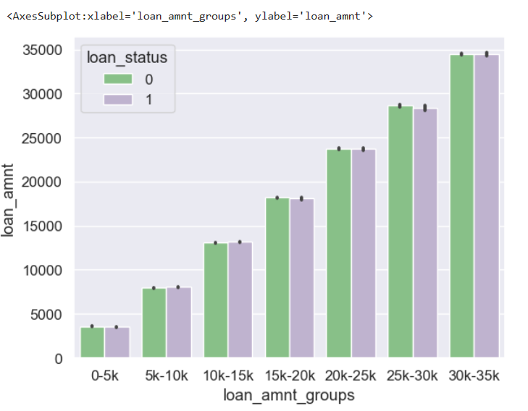
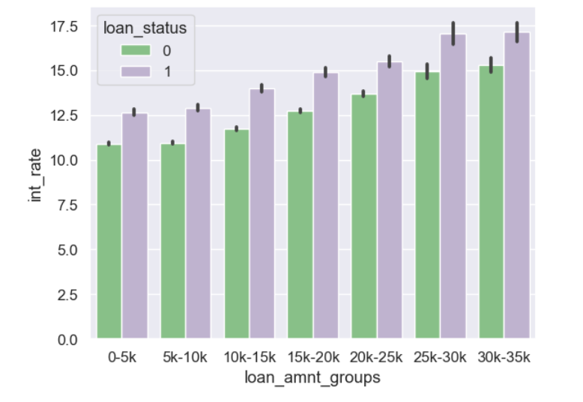
Continued…
Applicants with 30K-35K loan amount are paying maximum interest.

Slide 13
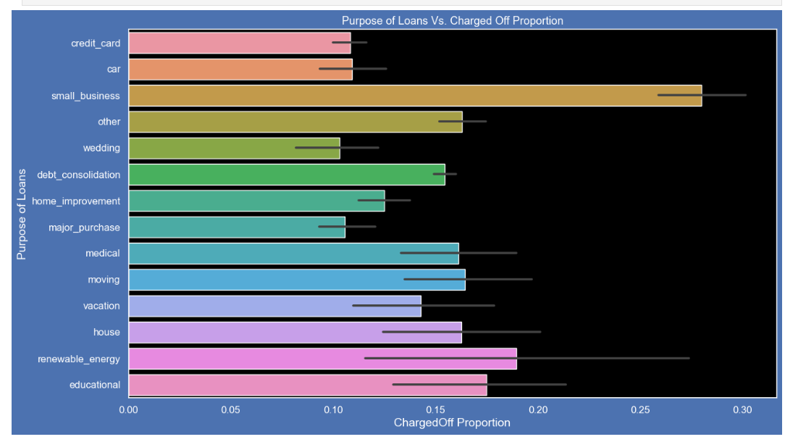
Continued…
Loan for Small business are most risky.

Slide 14
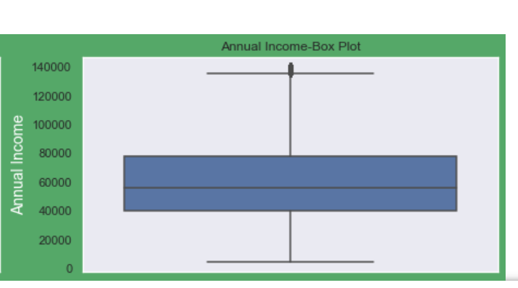
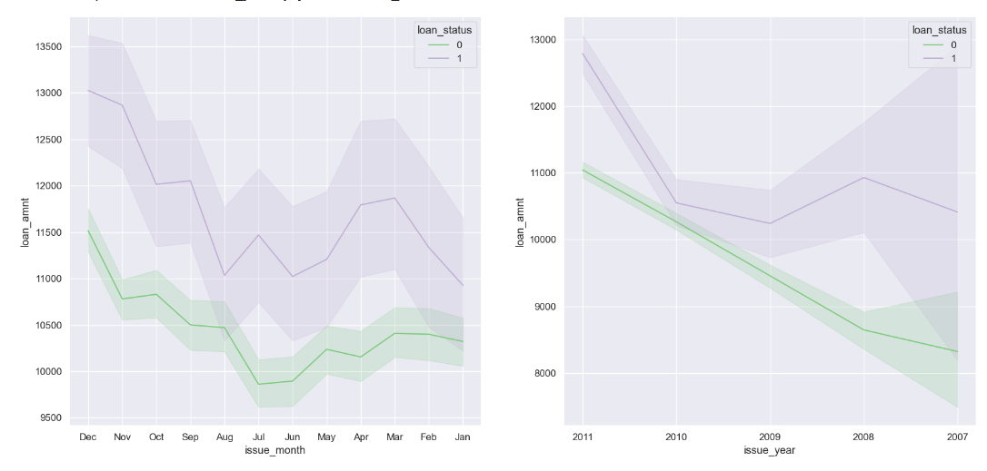
Important visuals

Slide 15
Conclusion
Loan with higher interest rate are having most chances to be charged off.
Loan amount is directly proportional to annual income.

